Slide 1
Software Systems Integration
Introduction and software development process

Slide 2
Project Planning
How and Who

Slide 3
How

Slide 4
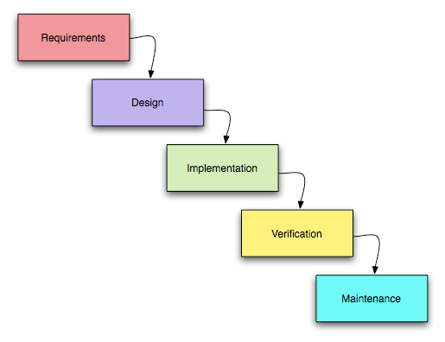
Waterfall…

Slide 5

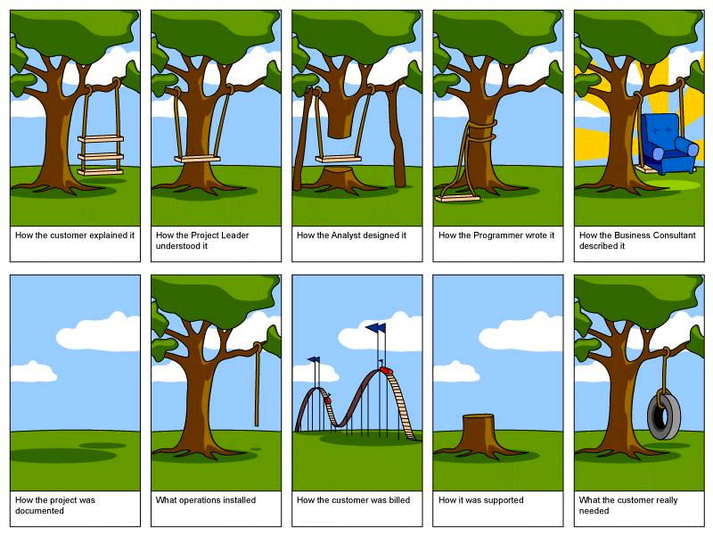
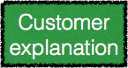

…results in

Slide 6



Plan: 4 years,
$7 000 000
Result: 14 years, $102 000 000

Slide 7

agent
Feedback
Actions
environment

Slide 8




Slide 9
Who
About managers…

Slide 10


Slide 11


Slide 12


Software Engineers
are different!

Slide 13
Agile
Individuals and interactions over processes and tools
Working software over comprehensive documentation
Customer collaboration over contract negotiation
Responding to change over following a plan

Slide 14
Lean Development
Eliminate waste
Amplify learning
Decide as late as possible
Deliver as fast as possible
Empower the team
See the whole: think big, act small, fail fast; learn rapidly

Slide 15
So

Slide 16
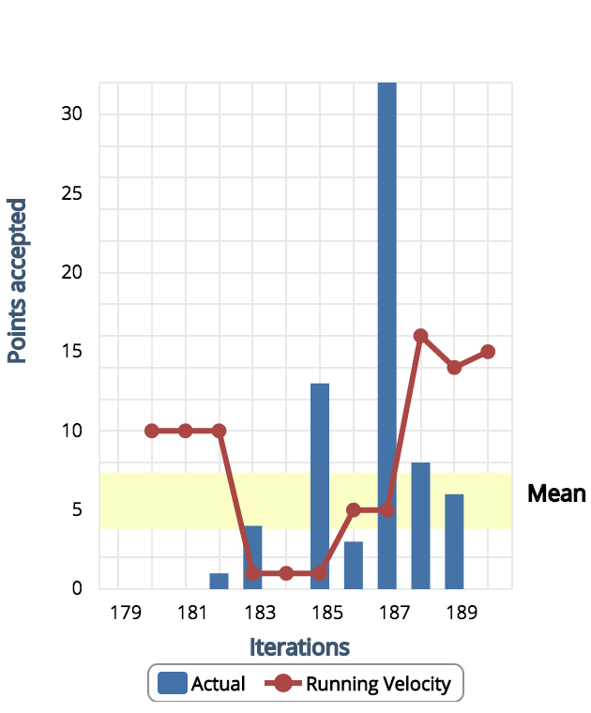
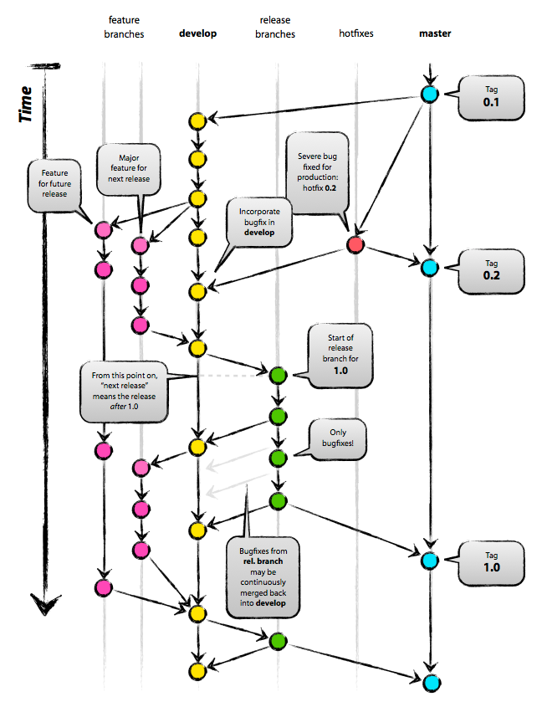
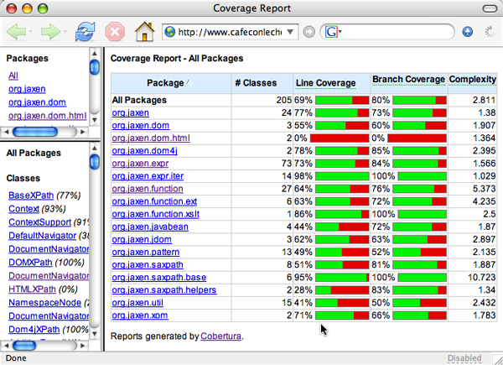



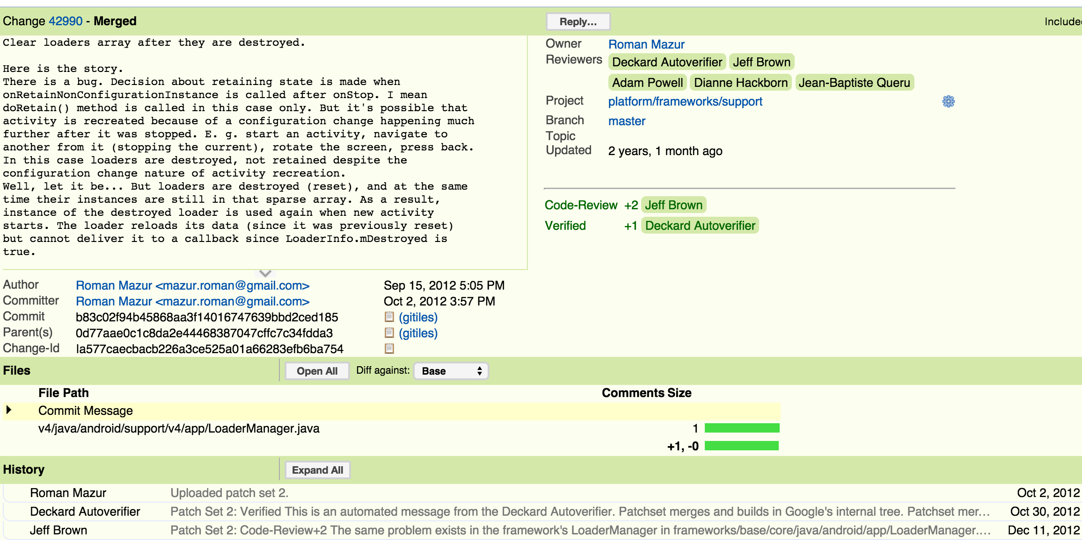
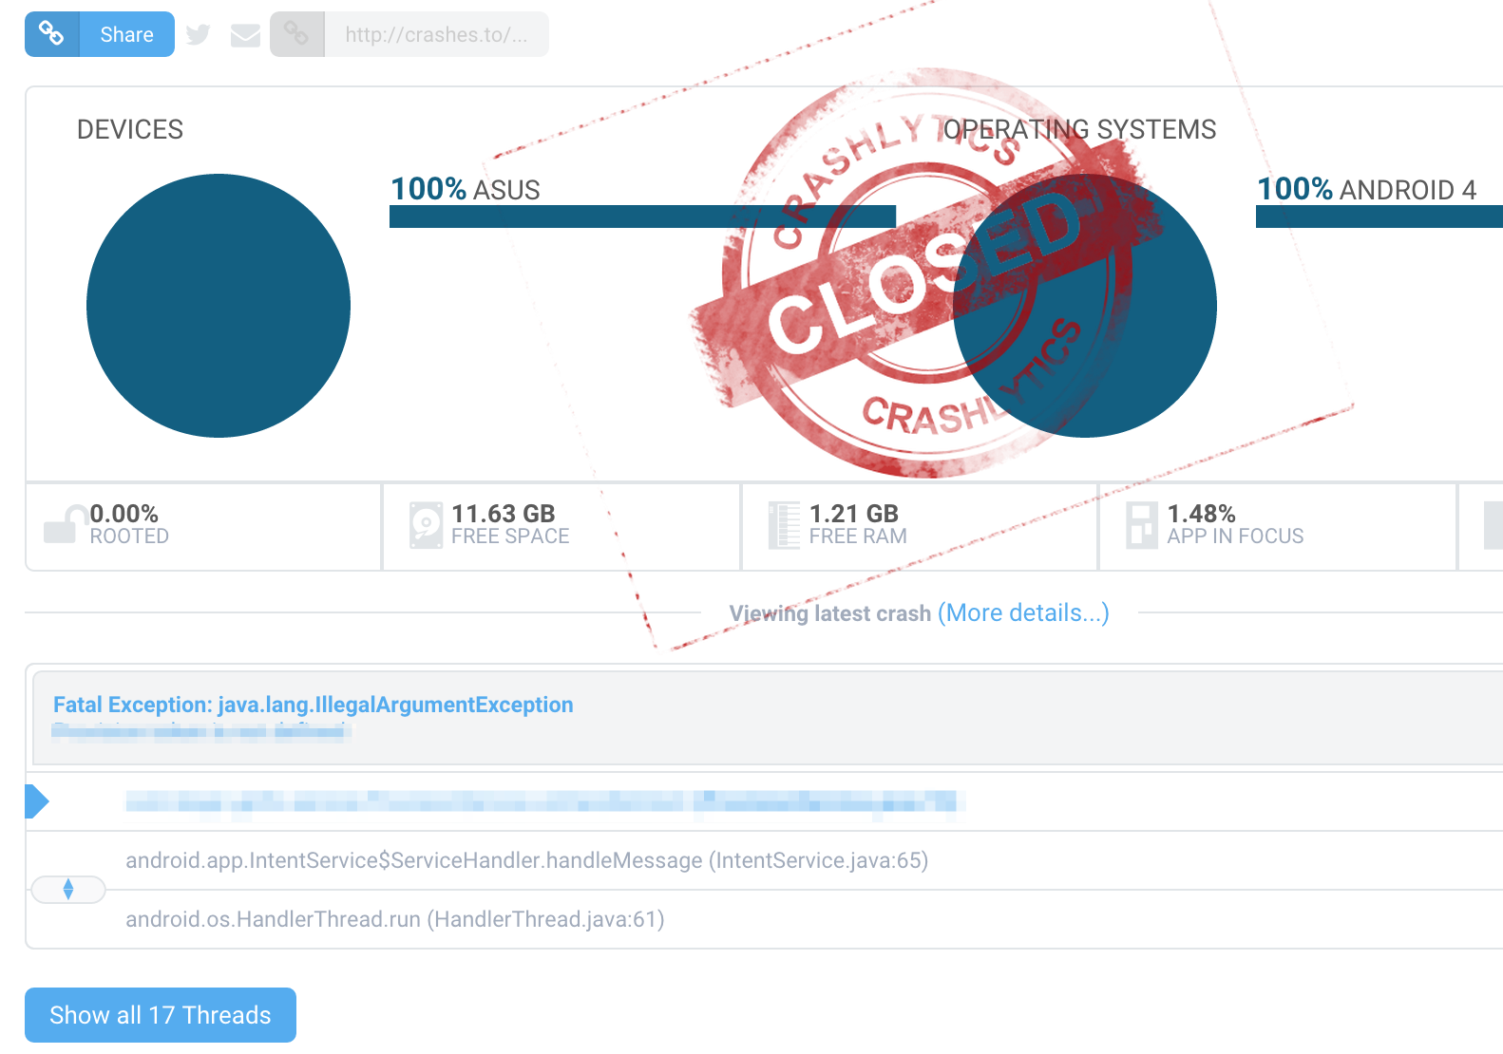
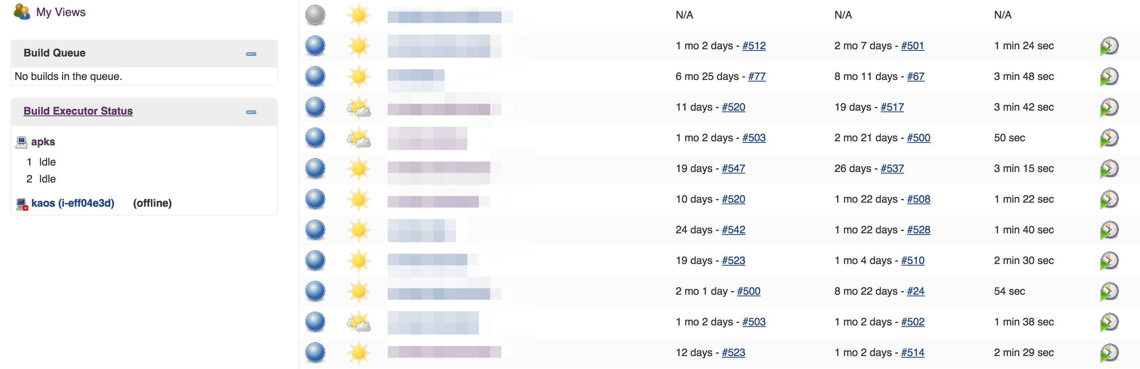
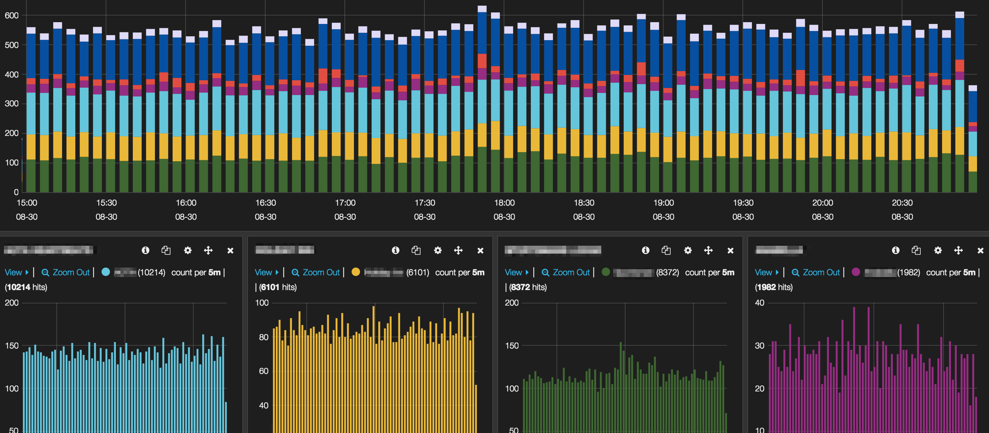
Syllabus

Slide 17
Grading
Choose your project on practice 1
Work on practice tasks in the context of your project
Make a report about your project, touching all the aspects from practice tasks

Slide 18
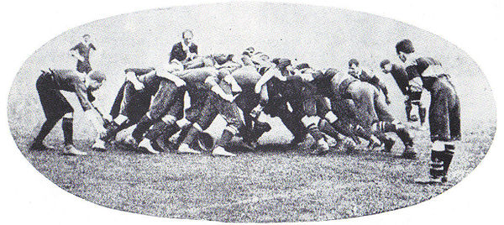
Scrum

Slide 19





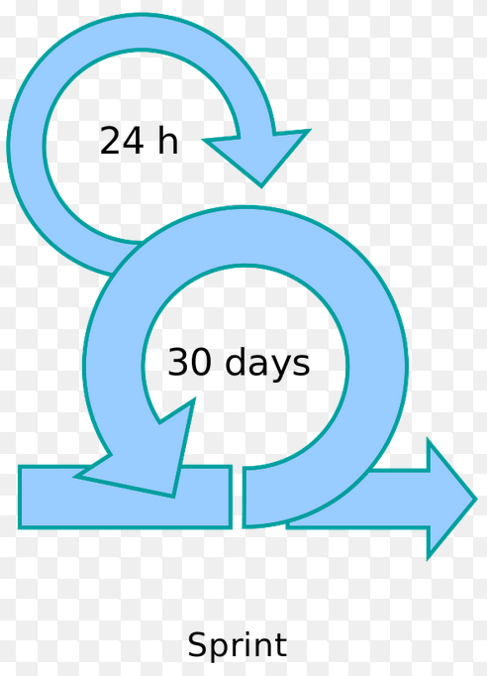
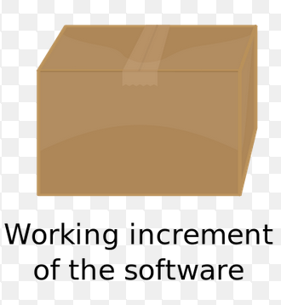
Scrum Master
Other Dev Team
Product Owner
Product Backlog
Sprint Board

Slide 20
Definition of Done
Code ready?
Reviewed?
Tested?
Deployed?
Activities to do per each
feature
sprint
release

Slide 21
Done is better than perfect.
(c) Mark Zuckerberg

Slide 22
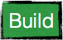



Slide 23
Scrum
Events
Sprint planning
Daily meeting
Retrospective
Roles
Product Owner
Scrum Master
Devs
Artifacts
Product Backlog
Sprint Board
Retrospective Results

Slide 24

Software War
“One Hacker Way”, Erik Meijer

Slide 25
Move fast, break things

